Slide 1
PICTORIAL DATABASE OF LPU’S PLANTS…

Slide 2

Keep the earth green
Scan it..

Slide 3
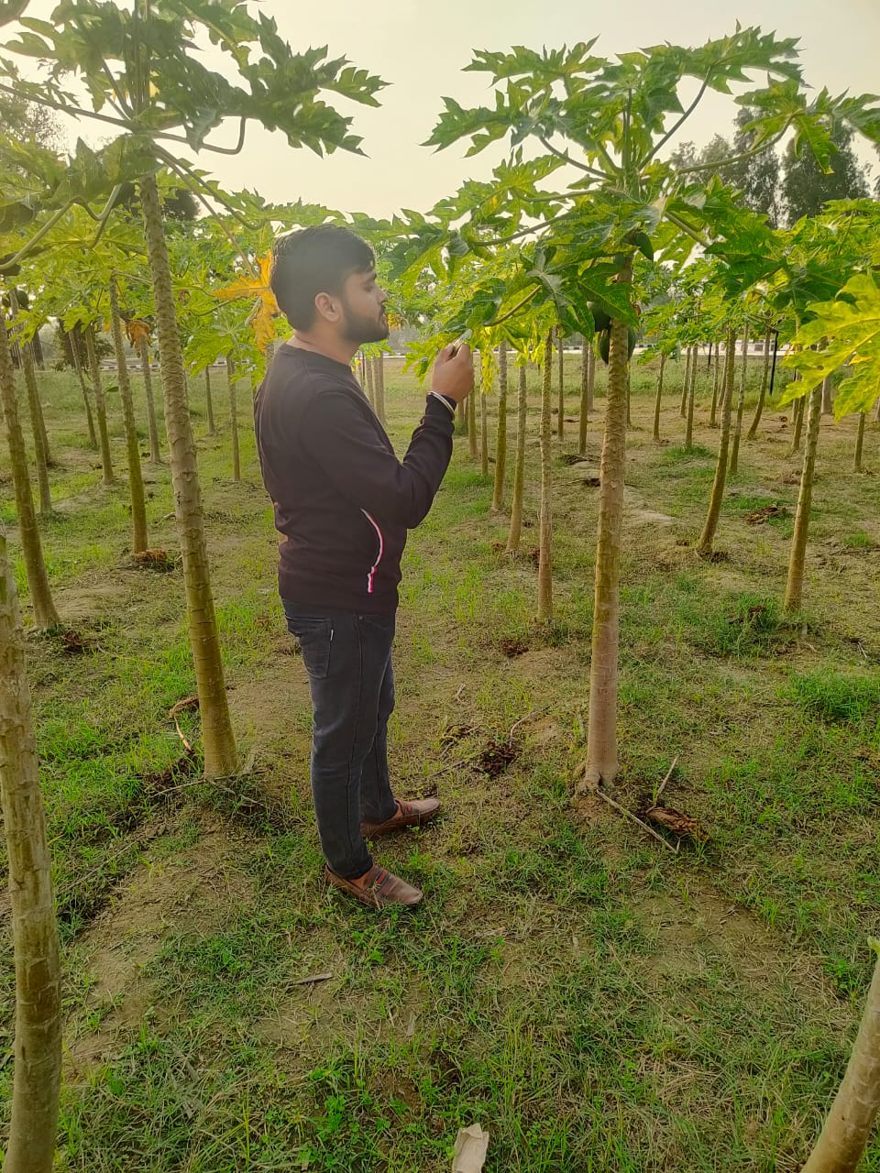
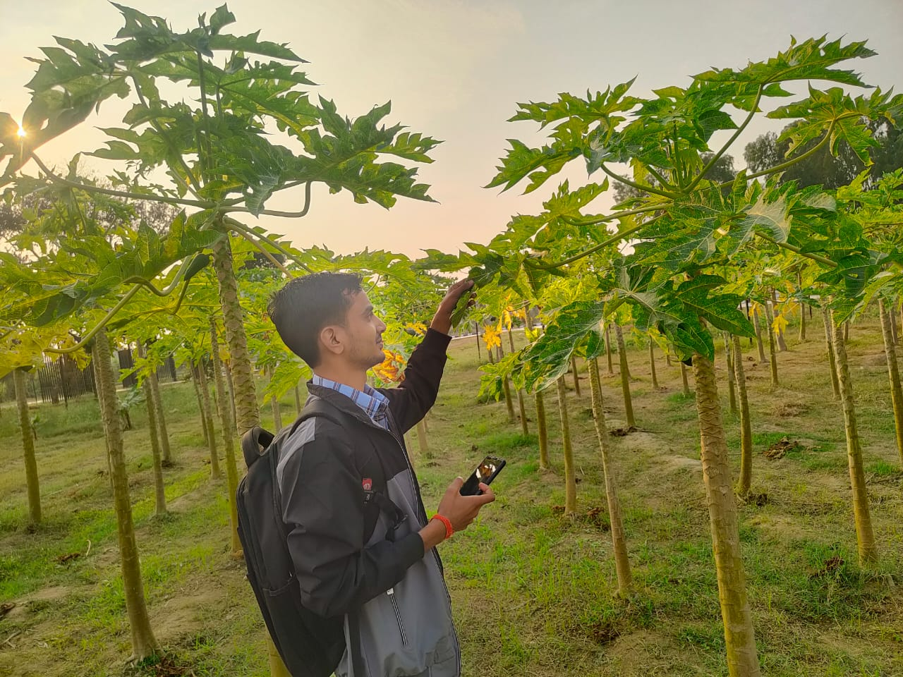
1. PAPAYA

Slide 4
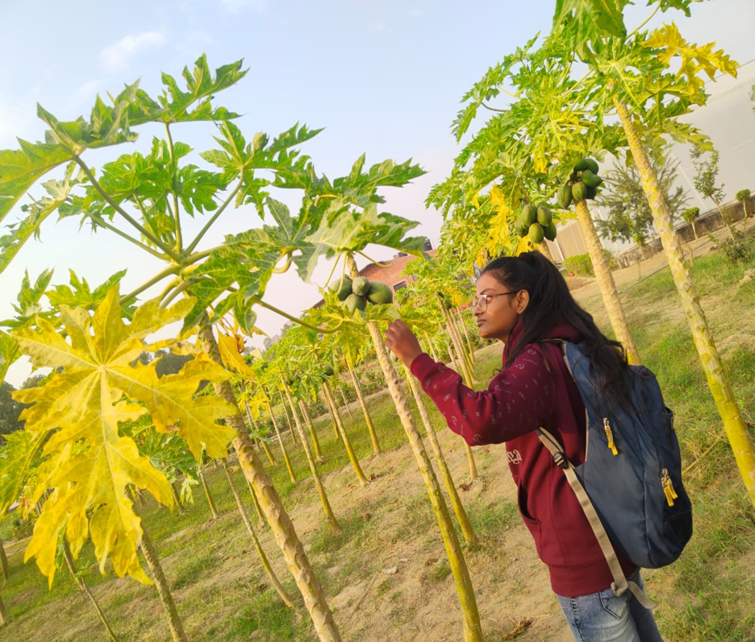
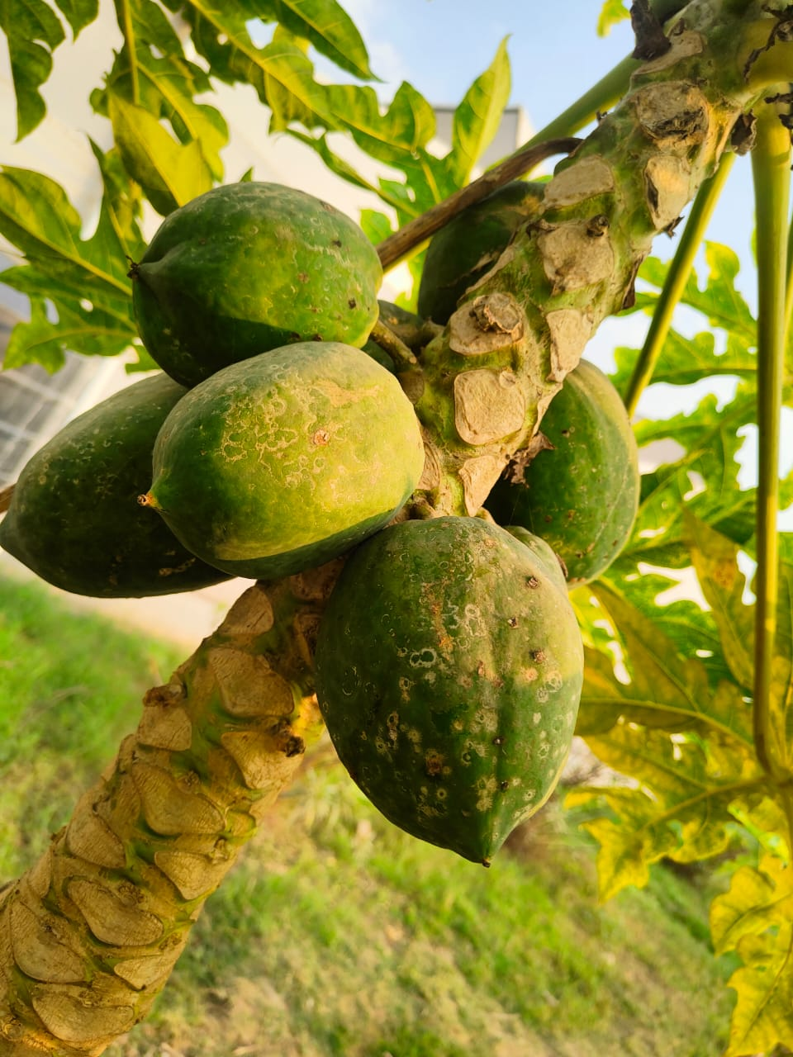
Here we are examine on papaya tree and try to distinguish between healthy tree and unhealthy tree…
And we found brown spot on fruits.

Slide 5
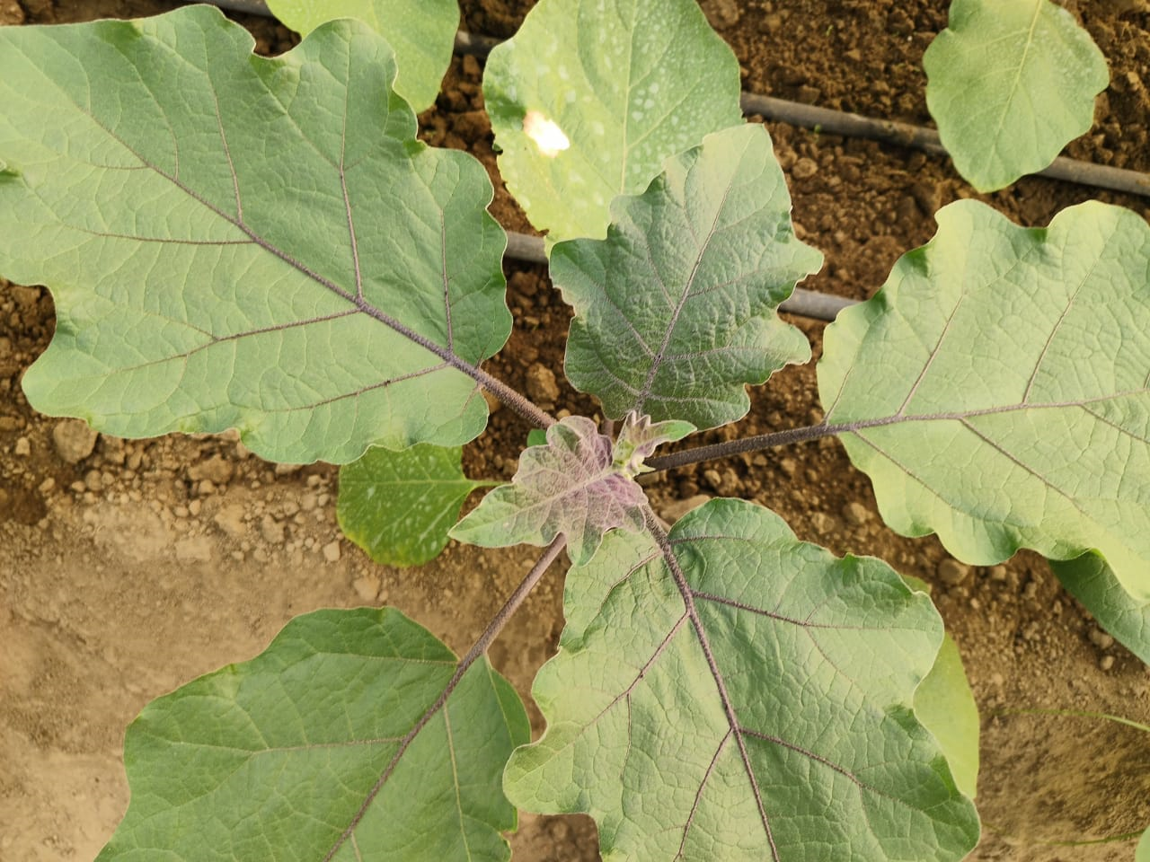
2.BRINJAL

Slide 6
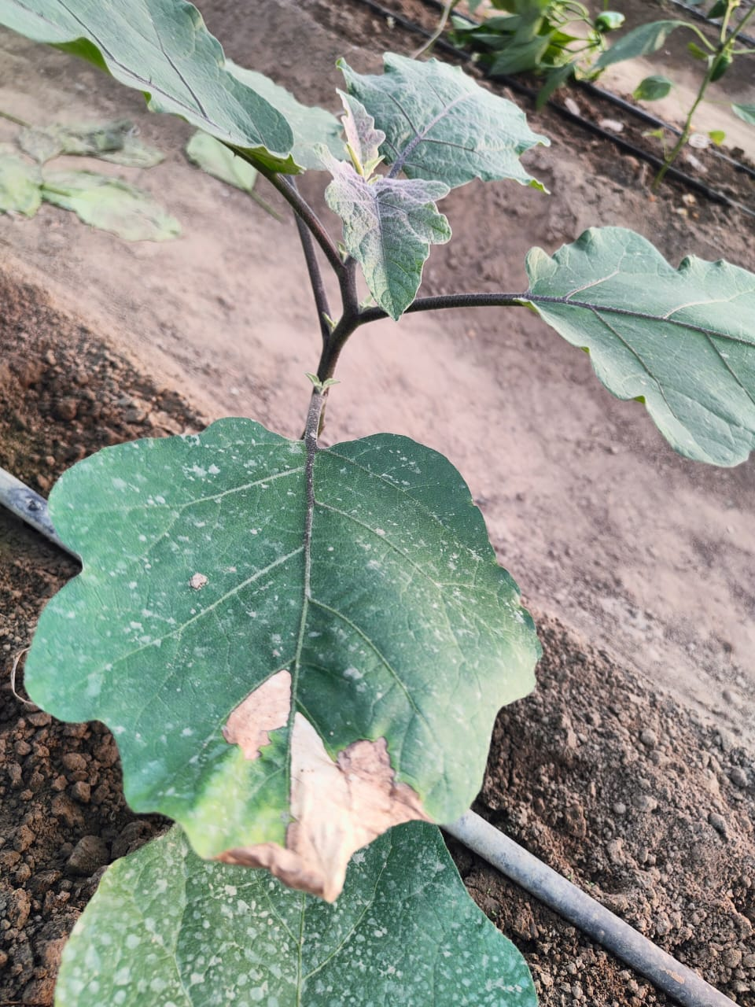
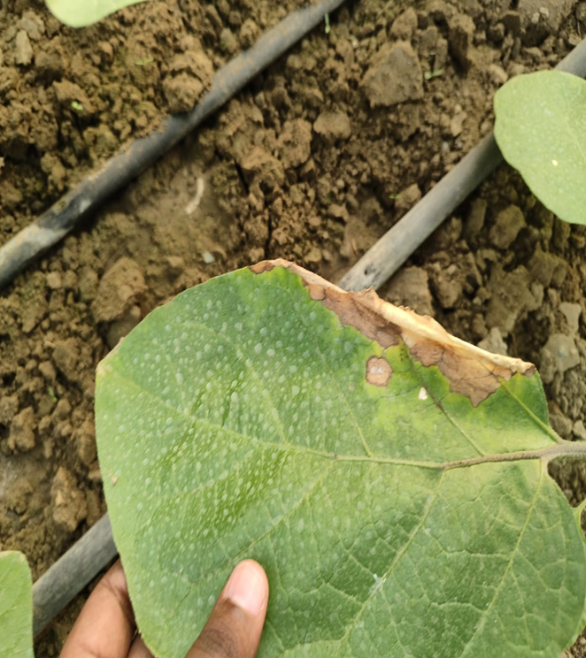
In Brinjal we all found Cercospora leaf spot which is caused by
Fungus….

Slide 7
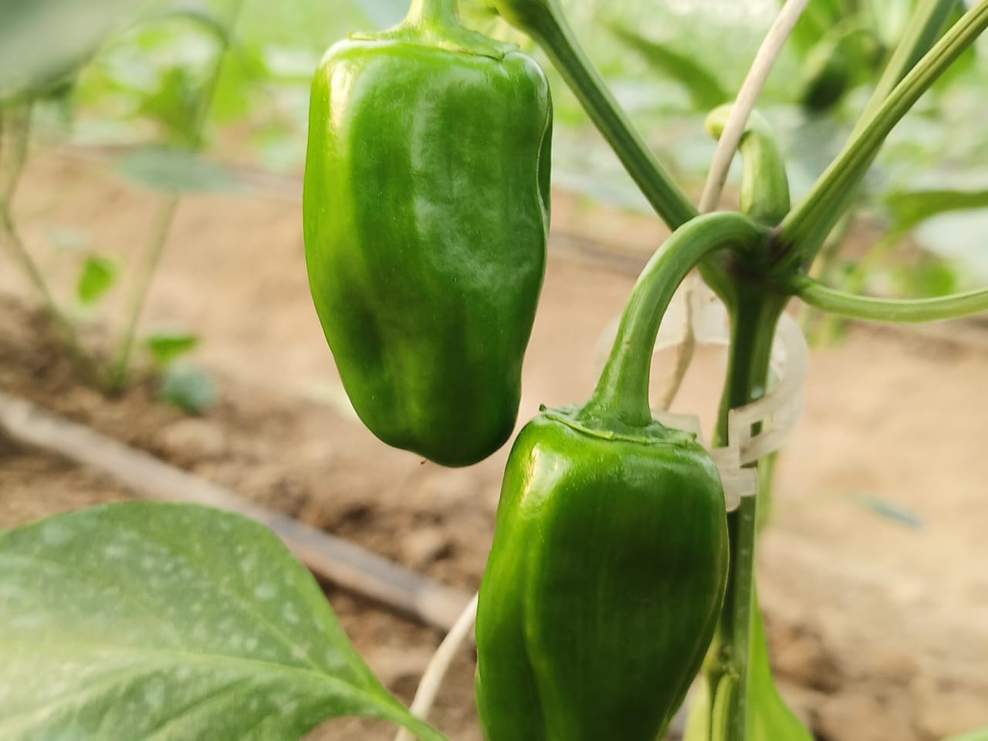
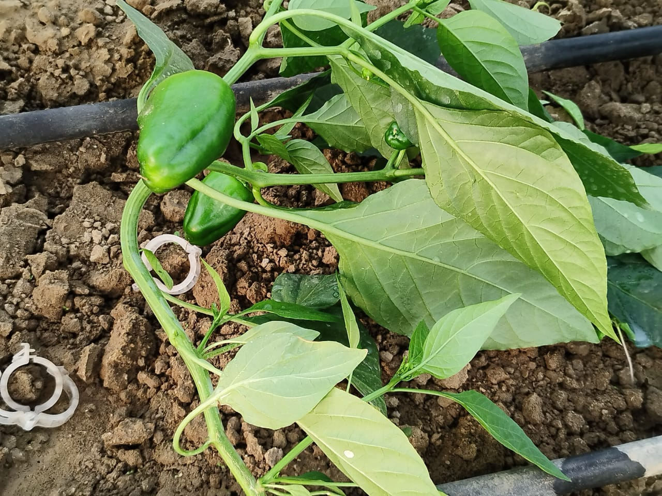
3.CAPSICUM

Slide 8
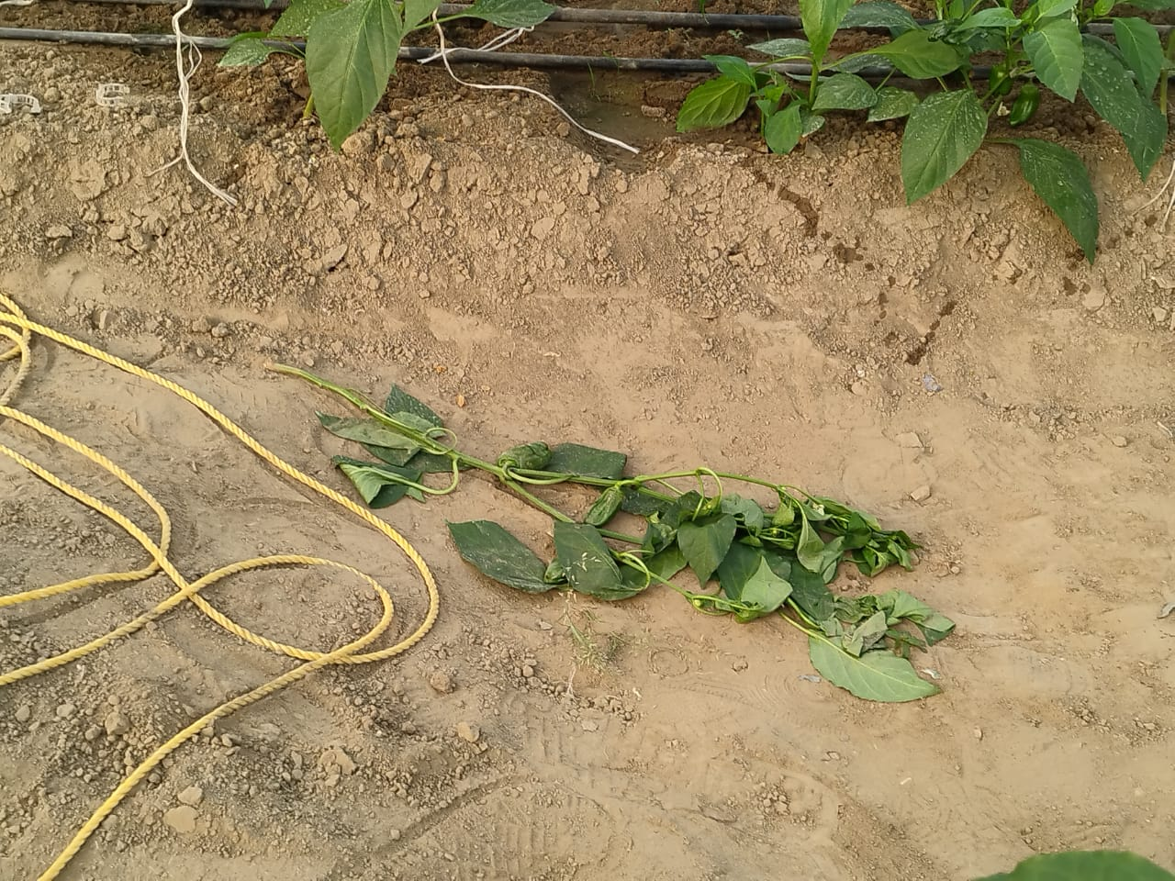
In Capsicum we found , Damping – off and root rot which is caused by Rhizoctonia , phytophthora like fungus disease…….

Slide 9
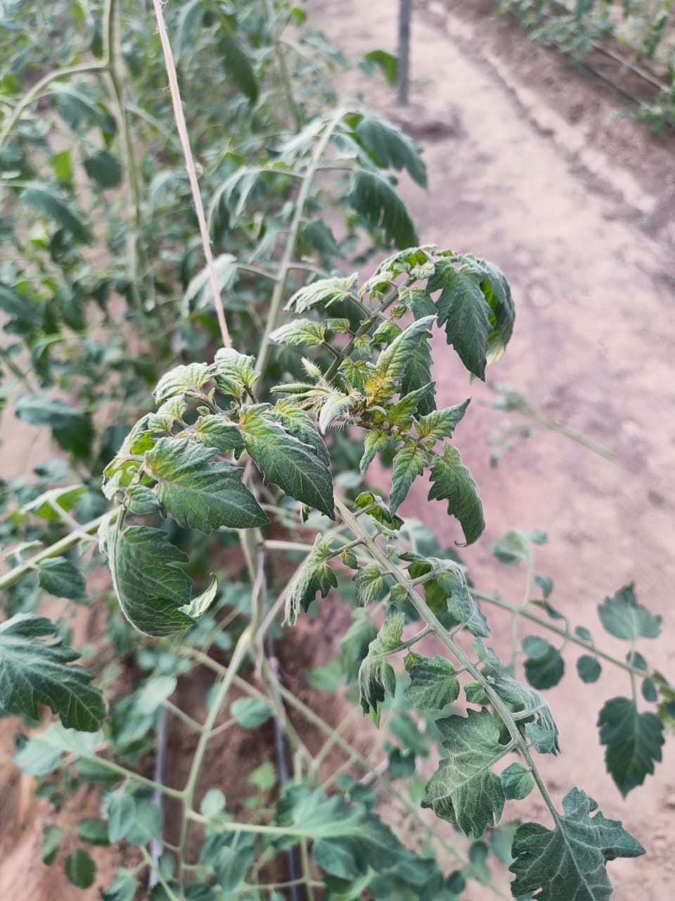
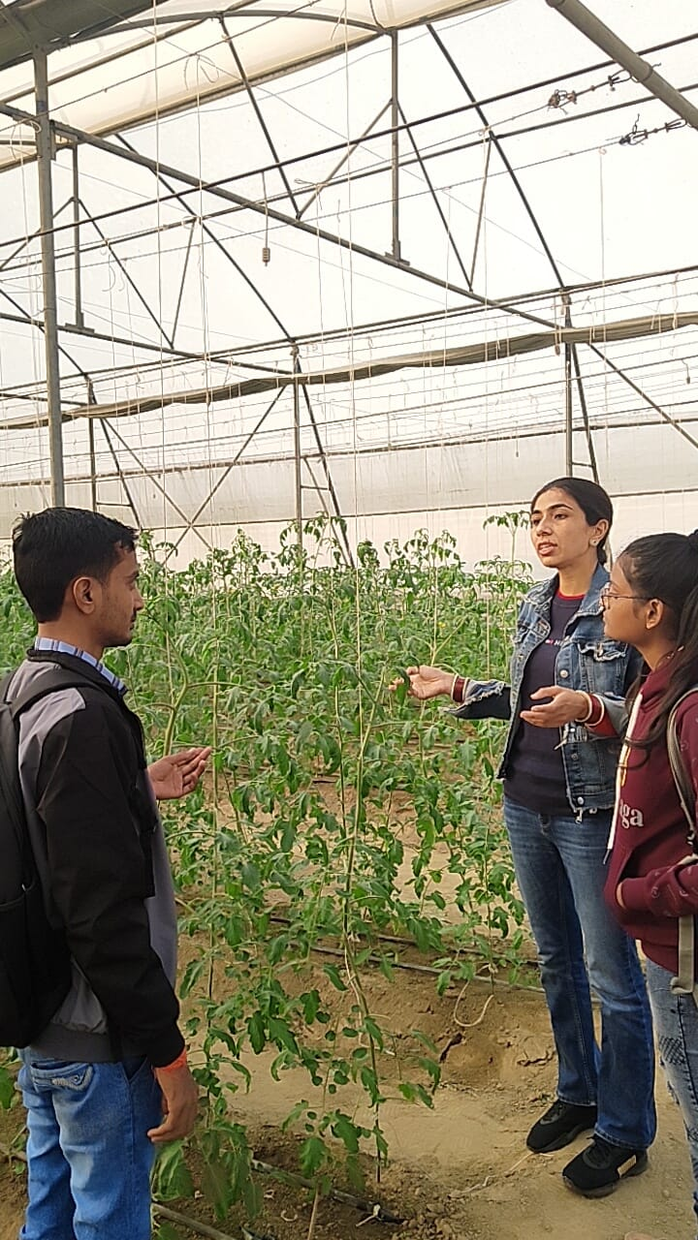
4.TOMATO

Slide 10
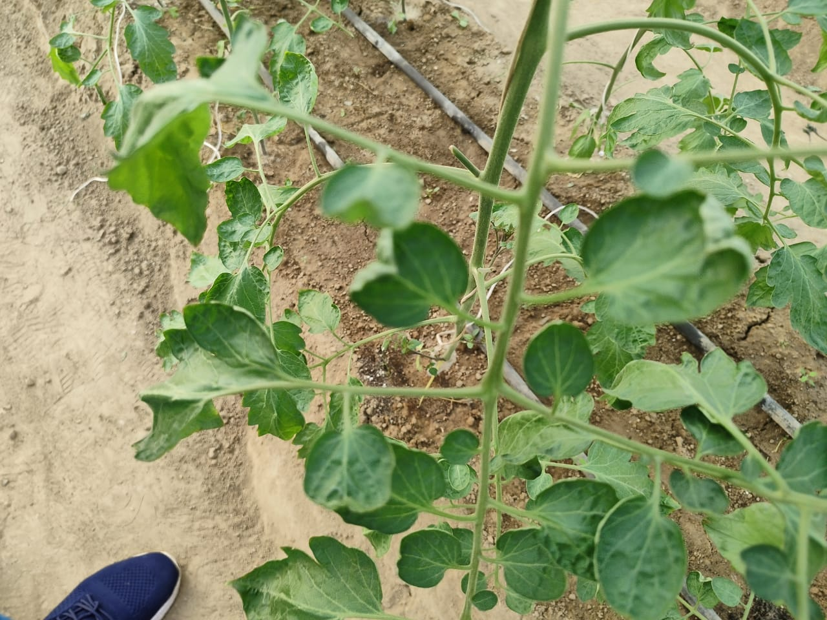
As during our project Tomato is seasonal crop so its our main focus..
Most of the tomato are infect by yellow leaf curl virus.it is mainly known to cause devastating losses of upto 100 % in the yeild of tomatoes….

Slide 11
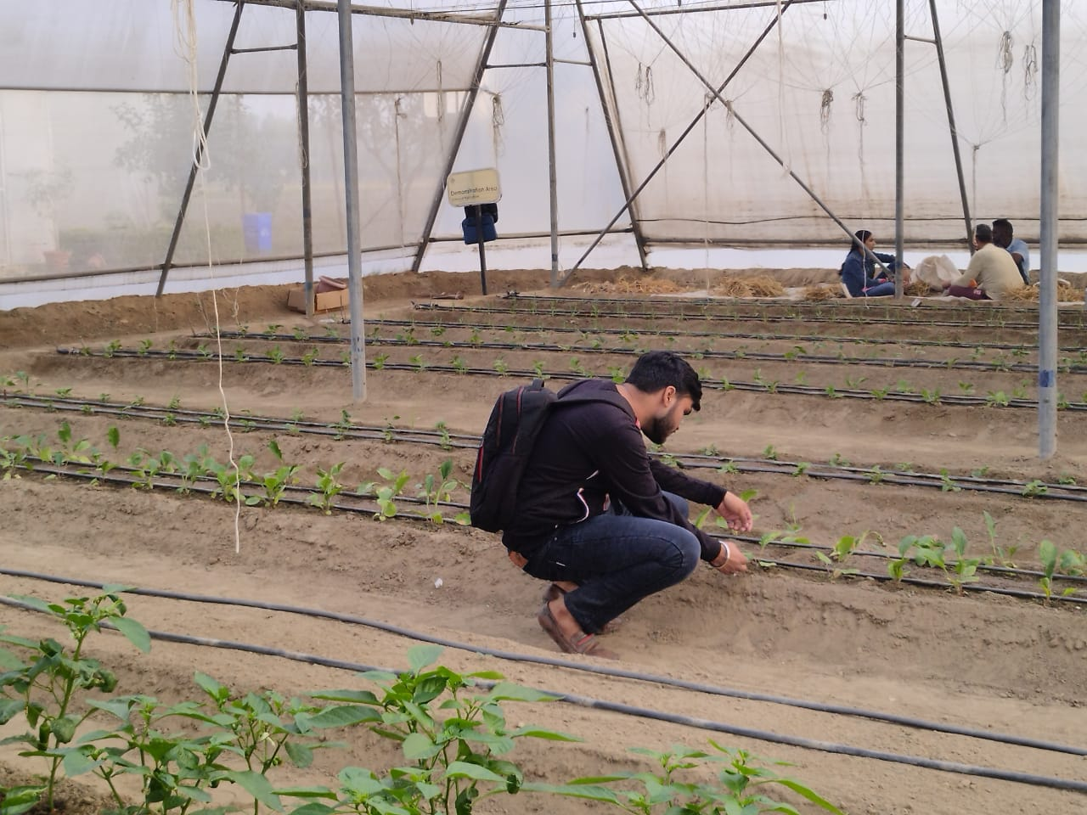
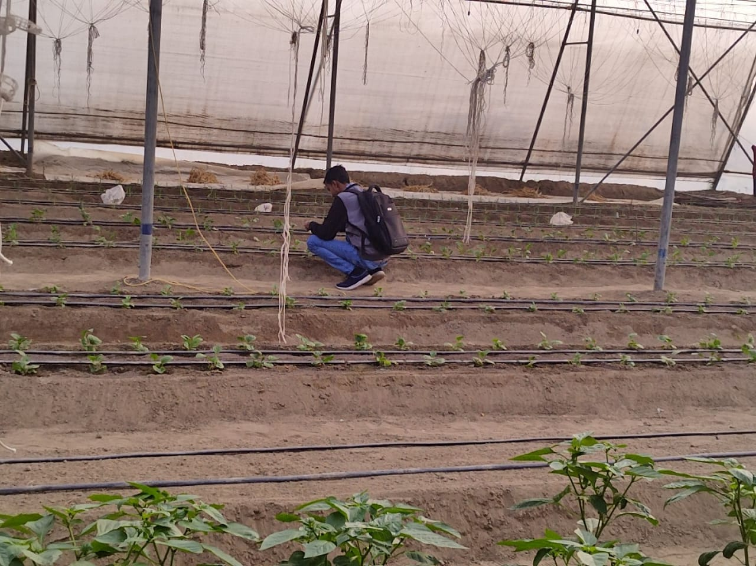
5.AGAVE PLANT

Slide 12
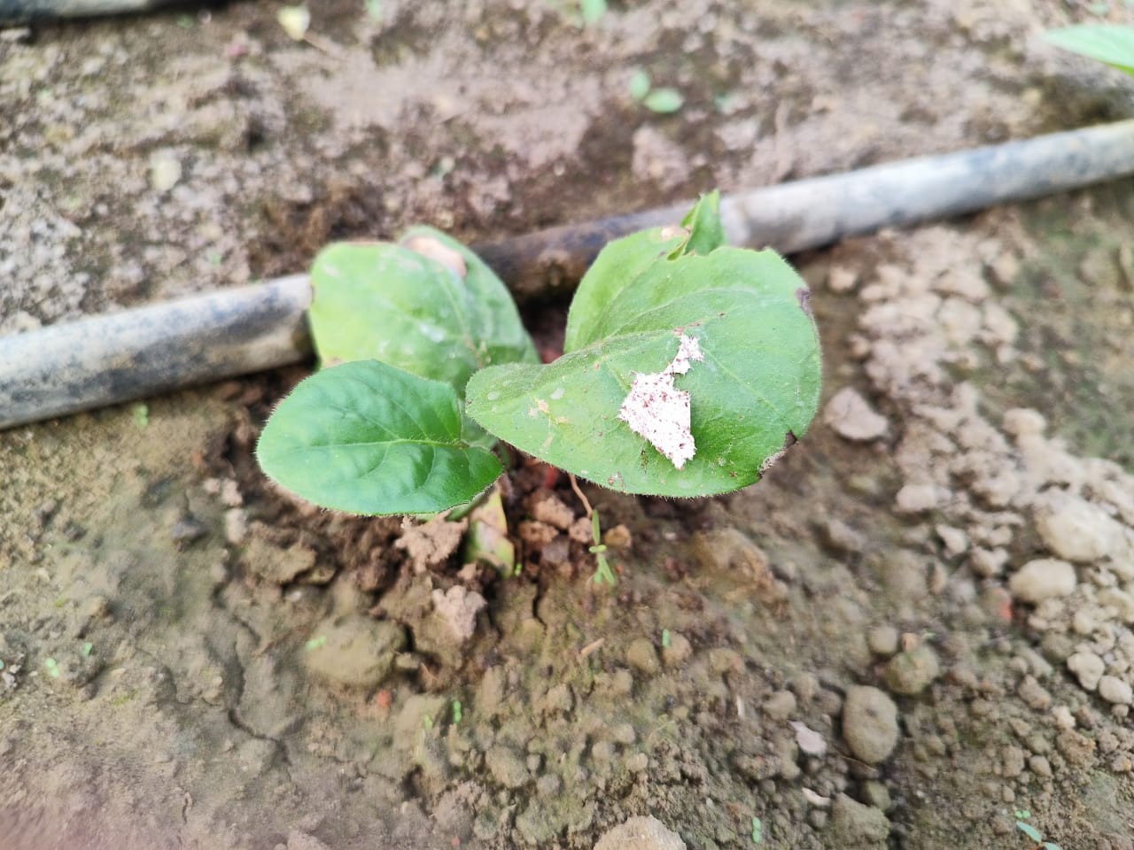
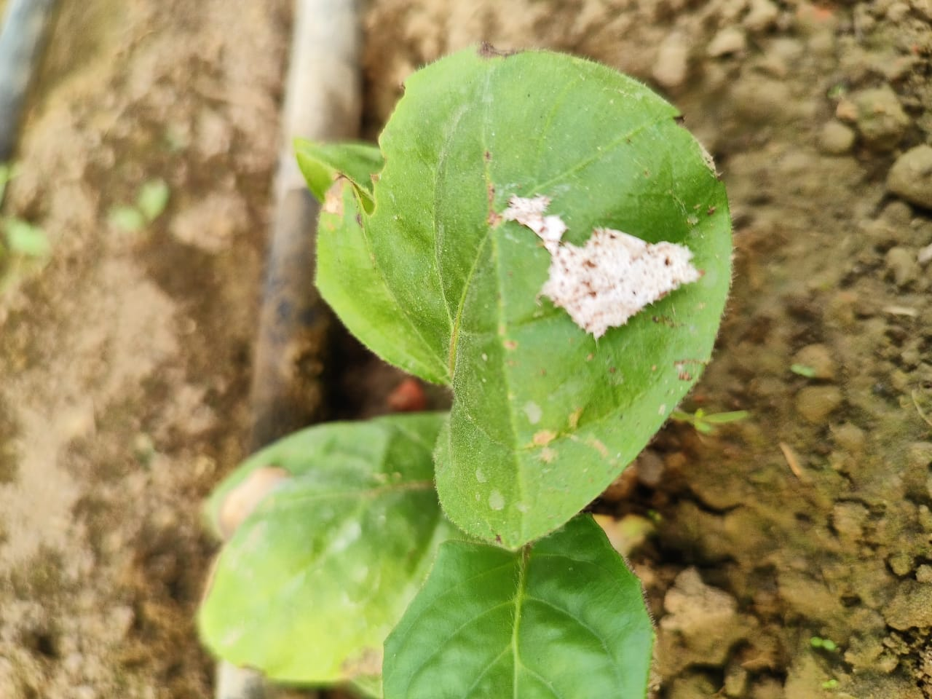
Agave plant is characterised by leathery leaves, and affected by white fungus is leaf which is caused by Colletotrichum is know as anthracnose

